Slide 1
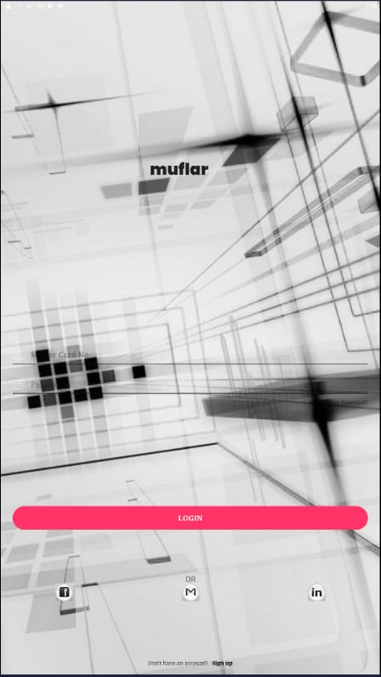

Slide 2
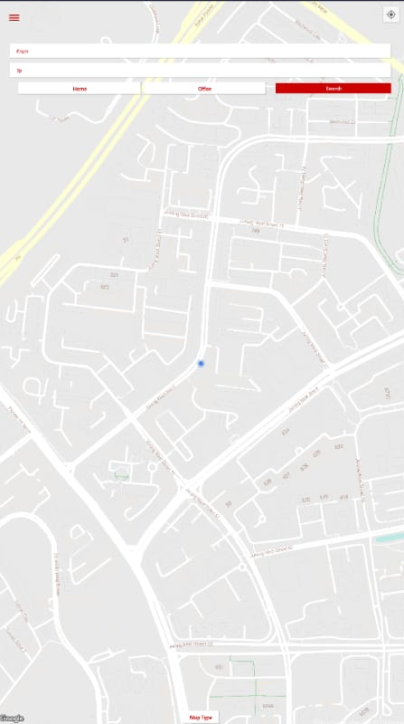
API function: post
Url: http://54.179.159.226:5000/busService/getETA
USER inputs from and To
MapType

Slide 3
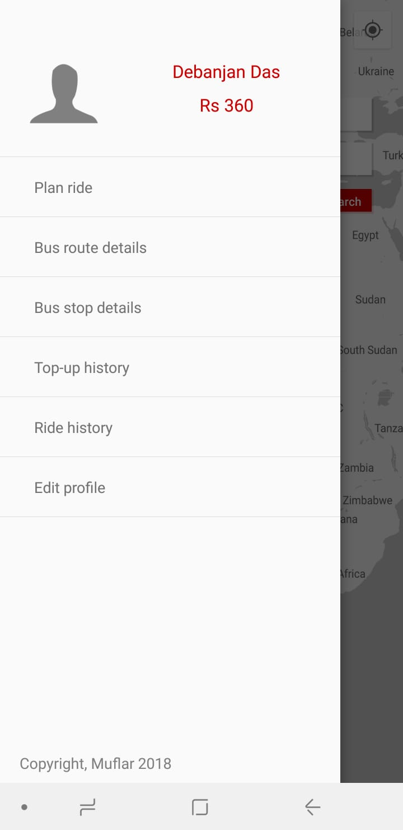
Parameter Input: LastName
Table 1 – User
Url: http://54.179.159.226:5000/users/CardNumber
Parameter Input: FirstName
Table 1 – User
Url: http://54.179.159.226:5000/users/CardNumber
Parameter Input: Balance
Table 6- Card
Url: http://54.179.159.226:5000/card/CardNumber
Sign out

Slide 4
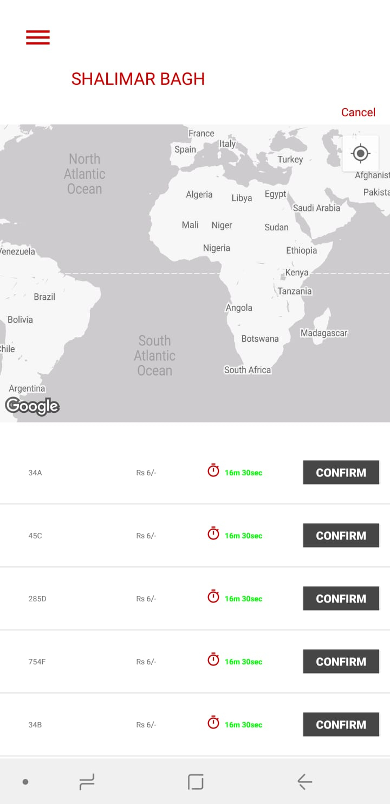
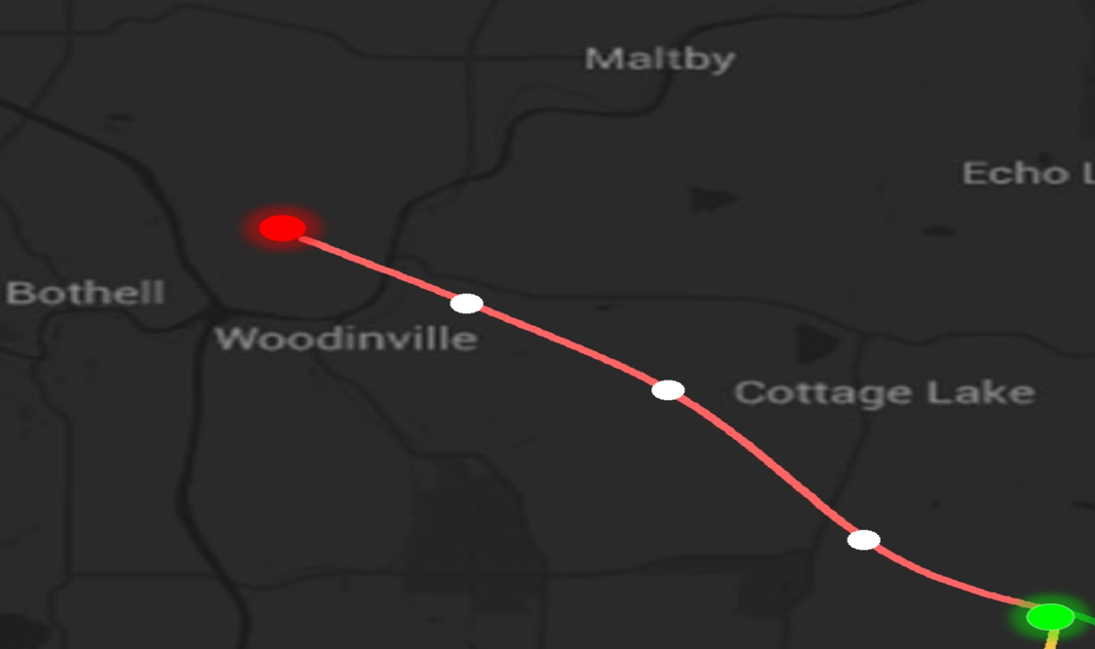
Parameter Input: From
Table 5 - Table_RouteFare
Url: http://54.179.159.226:5000/routefare/From/To/FromTo
Shalimar
Bagh
Parameter Input: To
Table 5 - Table_RouteFare
Url: http://54.179.159.226:5000/routefare/From/To/FromTo
Parameter Input: BusRoute
Url: http://54.179.159.226:5000/busService/getETA
MapType
Parameter Input: Fare
Url: http://54.179.159.226:5000/busService/getETA
Parameter Input: ETA
Url: http://54.179.159.226:5000/busService/getETA

Slide 5
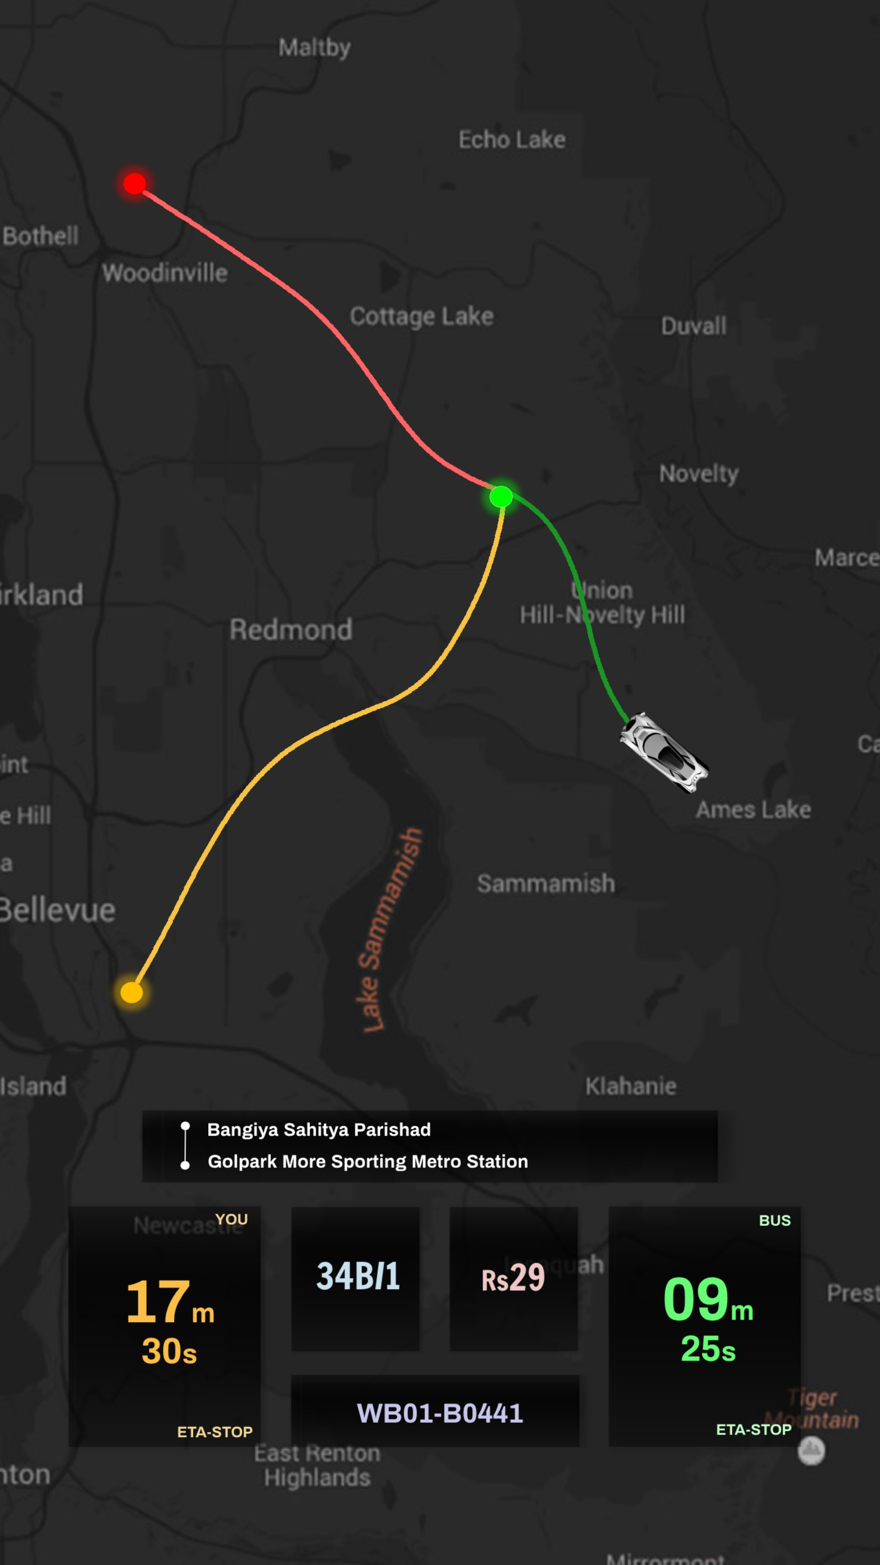


GO TO HOME SCREEN
GO TO Previous page
MapType
Cancel
TO
FROM
USER
BUS
FROM
Parameter Input: From, To
Table 5 - Table_RouteFare
Url: http://54.179.159.226:5000/routefare/From/To/FromTo
TO
Parameter Input: Fare
Url: http://54.179.159.226:5000/busService/getETA
Parameter Input: BusRoute
Url: http://54.179.159.226:5000/busService/getETA
USER ETA to “FROM” (based on google map api)
Parameter Input: ETA
Url: http://54.179.159.226:5000/busService/getETA
Parameter Input: BusID
Url: http://54.179.159.226:5000/busService/getETA

Slide 6
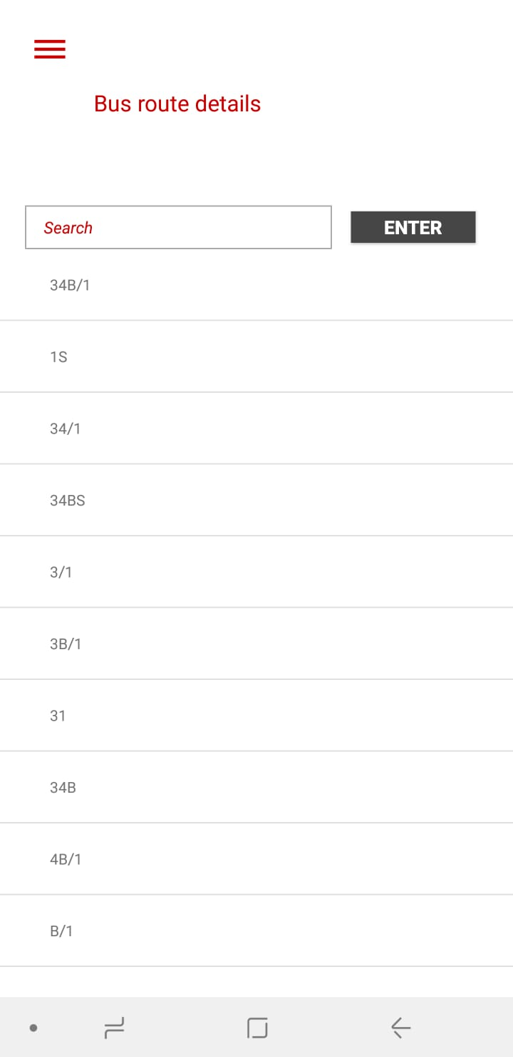
Parameter Input: All Bus Routes (Take unique value)
Table 4 – BusStops
http://54.179.159.226:5000/busstops

Slide 7
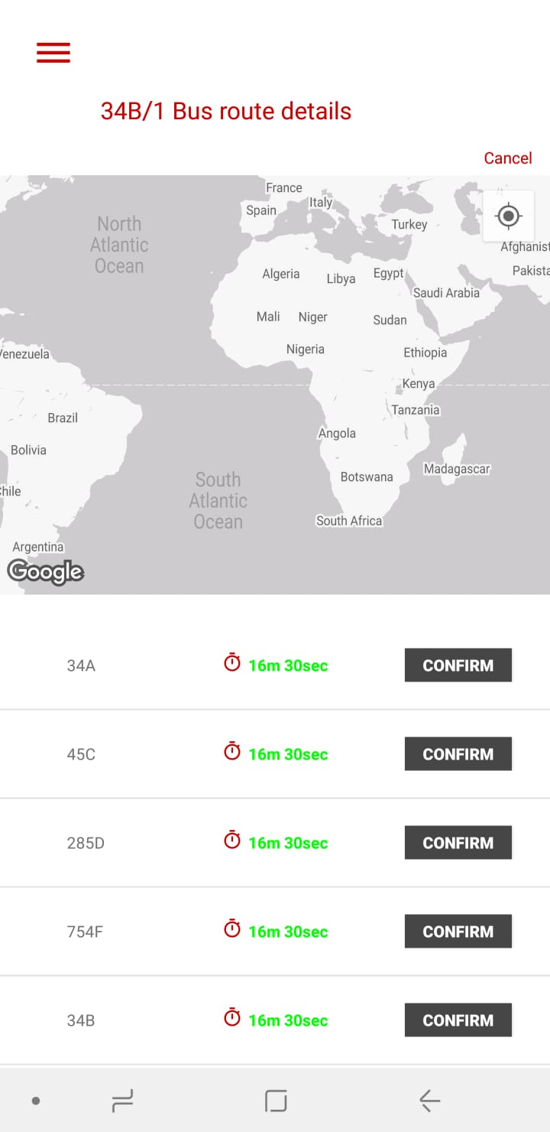
SHOW USER TO FROM
Parameter Input: BusRoute (User's "Confirm"ed parameter)
Table 4 – BusStops
http://54.179.159.226:5000/busstops/busroute/BusRoute
Parameter Input: Bus Stops
Url: http://54.179.159.226:5000/busService/getETA
MapType
Parameter Input: ETA (nearest BusID corresponding to that particular bus Route)
Url: http://54.179.159.226:5000/busService/getETA

Slide 8
FROM
GO TO HOME SCREEN
GO TO Previous page
MapType
Cancel
USER
BUS
FROM
Parameter Input: Stop (User's "Confirm"ed parameter)
Url: http://54.179.159.226:5000/busService/getETA
Parameter Input: BusRoute
Url: http://54.179.159.226:5000/busService/getETA
--
USER ETA to “FROM” (based on google map api)
Parameter Input: ETA
Url: http://54.179.159.226:5000/busService/getETA
Parameter Input: BusID
Url: http://54.179.159.226:5000/busService/getETA

Slide 9
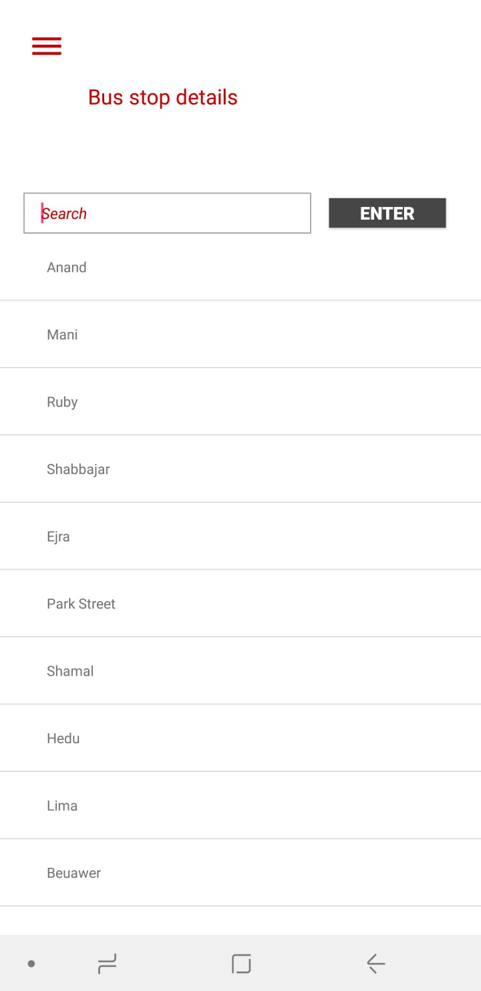
Parameter Input: All Bus Stops (By default)
Table 4 – BusStops
Url: http://54.179.159.226:5000/busstops

Slide 10
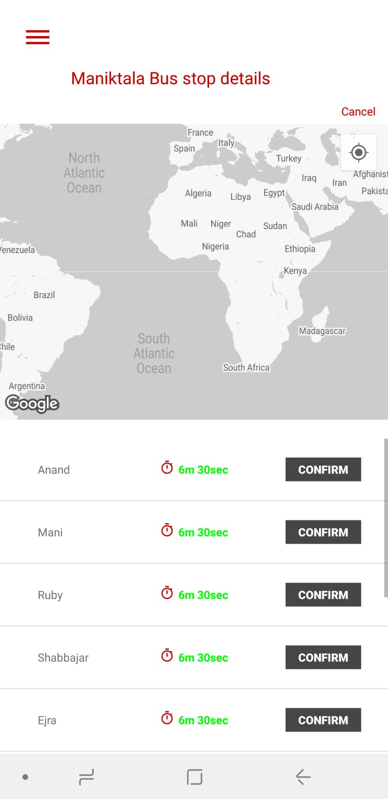
Parameter Input: Stop (User's "Confirm"ed parameter)
Table 4 – BusStops
http://54.179.159.226:5000/busstops/Stops
Parameter Input: BusRoute
Url: http://54.179.159.226:5000/busService/getETA
MapType
Parameter Input: ETA (nearest BusID corresponding to that particular bus Route)
Url: http://54.179.159.226:5000/busService/getETA

Slide 11
FROM
GO TO HOME SCREEN
GO TO Previous page
MapType
Cancel
USER
BUS
FROM
Parameter Input: busstop (User's "Confirm"ed parameter)
Url: http://54.179.159.226:5000/busService/getETA
Parameter Input: BusRoute
Url: http://54.179.159.226:5000/busService/getETA
--
USER ETA to “FROM” (based on google map api)
Parameter Input: ETA
Url: http://54.179.159.226:5000/busService/getETA
Parameter Input: BusID
Url: http://54.179.159.226:5000/busService/getETA

Slide 12
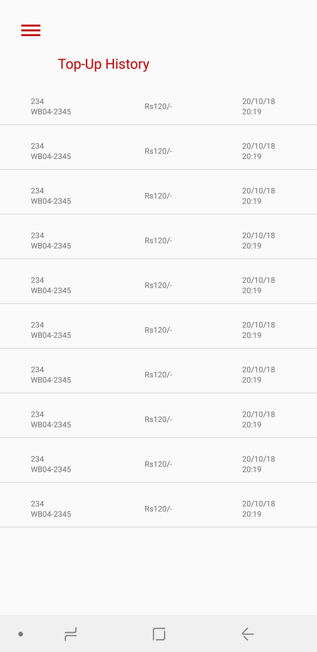
Parameter Input: Amount
Table 7- Top-up History
http://54.179.159.226:5000/topuphistory/CardID/CardNumber
Parameter Input: Recharge_Date*
Table 7- Top-up History
http://54.179.159.226:5000/topuphistory/CardID/CardNumber
Parameter Input: Recharge_Time*
Table 7- Top-up History
http://54.179.159.226:5000/topuphistory/CardID/CardNumber
Parameter Input: Bus Route
Table 7- Top-up History
http://54.179.159.226:5000/topuphistory/CardID/CardNumber
Parameter Input: Bus ID
Table 7- Top-up History
http://54.179.159.226:5000/topuphistory/CardID/CardNumber

Slide 13
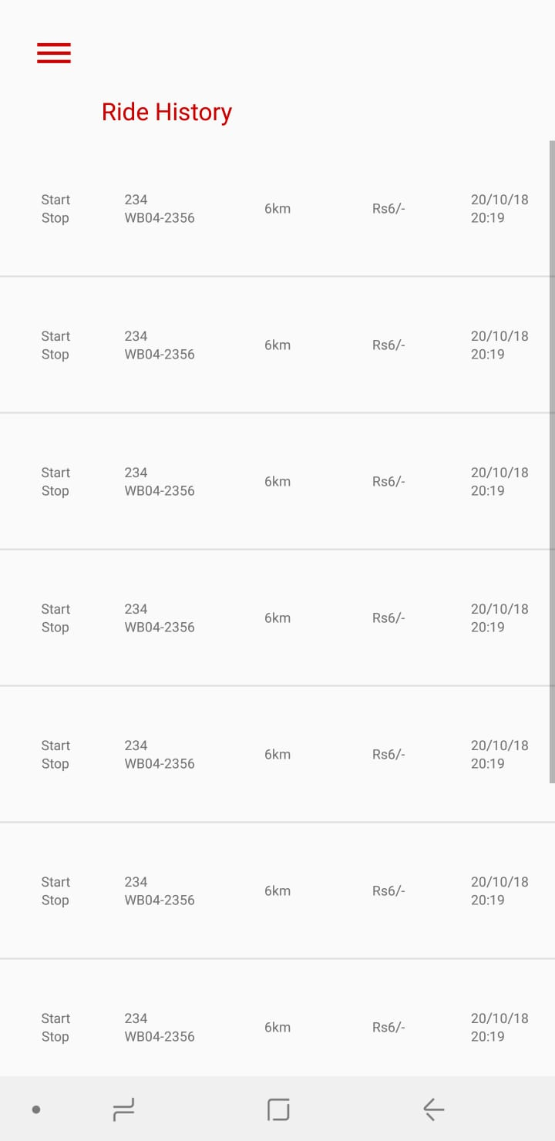
Parameter Input: Travel_Date*
Table 8- Ride History
http://54.179.159.226:5000/rideHistory/CardID/CardNumber
Parameter Input: Entry_Time*
Table 8- Ride History
http://54.179.159.226:5000/rideHistory/CardID/CardNumber
Parameter Input: FareCharged
Table 8- Ride History
http://54.179.159.226:5000/rideHistory/CardID/CardNumber
Parameter Input: BusRoute
Table 8- Ride History
http://54.179.159.226:5000/rideHistory/CardID/CardNumber
Parameter Input: BusID
Table 8- Ride History
http://54.179.159.226:5000/rideHistory/CardID/CardNumber
Parameter Input: Entry
Table 8- Ride History
http://54.179.159.226:5000/rideHistory/CardID/CardNumber
Parameter Input: Exit
Table 8- Ride History
http://54.179.159.226:5000/rideHistory/CardID/CardNumber

Slide 14
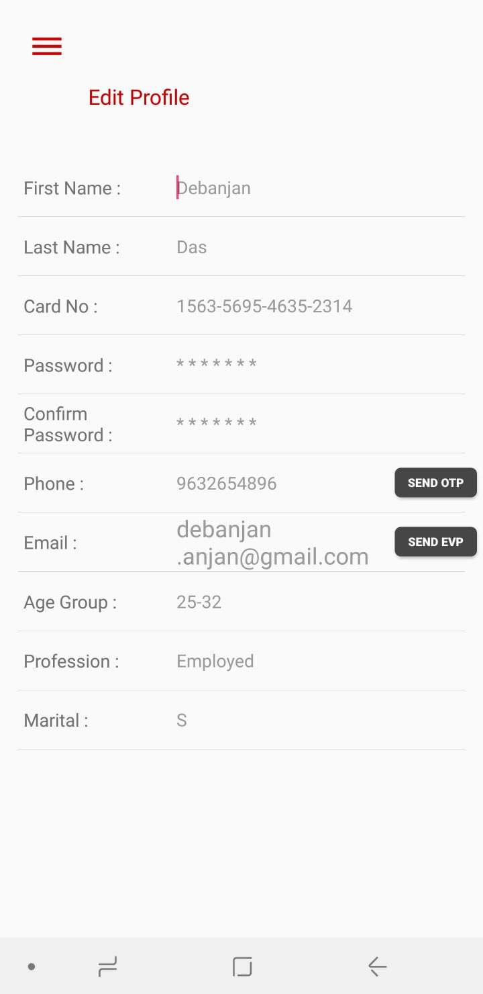
Data from Table 1
Table 1- User
http://54.179.159.226:5000/users/CardNumber
CARD NUMBER WILL NEVER CHANGE FOR ONE PROFILE
Home:
Data from Table 1
API type: POST
Parameter:
Table 1- User (All – except card number)
Table 6- Cards (FirstName, LastName)
http://54.179.159.226:5000/??
Office:
SAVE

